Slide 1
Project Overview & Presentation
SUPPORT AI TICKET MANAGEMENT AGENT
Integrating Llama 3.2 Chatbot and sentimental analysis, SQLite Analytics, and data dashboards with KPI cards
- Abhiram Girkabai

Slide 2
The IT Support Bottleneck & Our Solution
The Bottlenecks
• Manual Ticket Categorization: IT staff waste hours checking and classifying incoming issues manually.
• Repetitive Queries: Technicians spend time answering duplicate employee questions instead of solving core bugs.
• Disconnected History: Past resolved ticket solutions exist in logs but are never recycled for live resolution.
The Support AI Answer
• AI Auto-Classification: Auto-detects category (e.g. Network, Hardware, Software) and priority via local AI model.
• Contextual AI Assitant: Embeds a chatbot right inside the ticket view to guide admin and technician using database history.
• Zero-Waste Resolutions: Auto-injects past ticket remarks into Llama 3.2 prompt context to offer pre-validated fixes.

Slide 3
System Architecture & Tech Stack
React Frontend
Interactive Client Portal
▫️ React State Machine: Handles view switching, ticket tracking, and connection diagnostics.
▫️ Peach Matte Style Guide: Soft peach backdrop, high-contrast black borders, smooth pill badges, and hover animations.
▫️ Dynamic Dashboards: Tabbed layout toggling Employee Forms, Technician Queues, and AI Admin Graphs.
Express Backend
Secure Database Server
▫️ RESTful API endpoints: Connects React to SQLite data pipelines (Fetch/Update/Resolve).
▫️ SQLite Storage: Stores employee profiles, ticket logs, priority metrics, and resolution remarks.
▫️ Leaderboard Aggregator: Runs real-time queries counting active vs resolved ratios.
Local Llama 3.2
Ollama Inference Engine
▫️ Locally Hosted Model: Runs llama3.2 VM at
▫️ llama3.2-powered chatbot: System prompt parses the current issue and also provides required information of the current raised ticket selected by comparing with previous similar threads and resolved remarks.
▫️ Offline Database Backup: Data of the employee’s ticket will be stored locally, promoting data safety
1
2
3

Slide 4
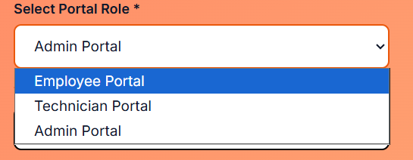
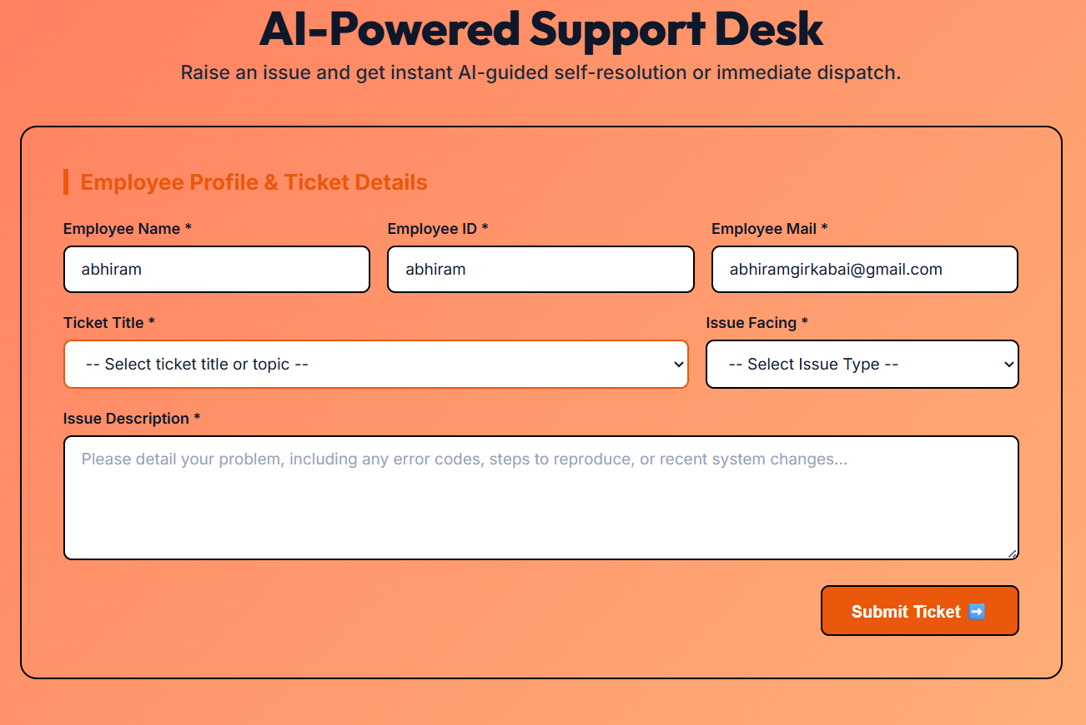
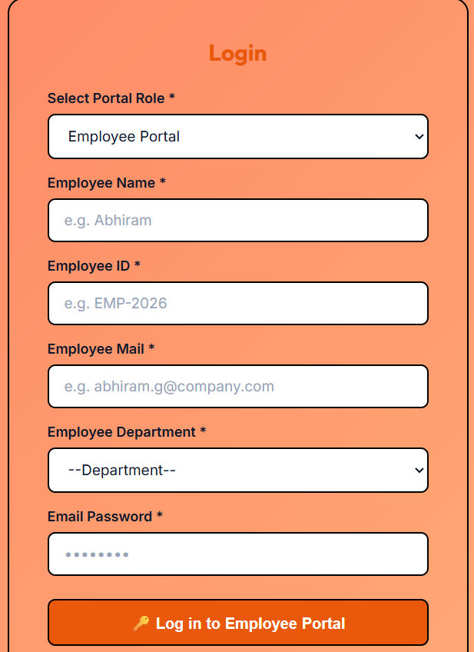
Login and System Environment

Slide 5
Ticket Logs and Llama3.2-Powered Chatbot
Ticket Details (Top Panel)
• List/Logs of the details of the tickets raised by the employee with the issue description • Shows employee, category, and priority of the raised ticket • It also provides a thread option which directs the admin or the technician to the llama 3.2- powered Chatbot to know more about the raised ticket
Access restriction
• With using the prior page user can choose Employee/Technician/ Admin portal to login • Using the portal selection result from the user the acess for the different services will be provided. • This promotes the safety and security of the data.
Chatbot (Bottom Panel)
• Integrated by the Ollama llama3.2 model
• Provides the details of the tickets raised by the employee along provides the previous similar tickets raised by other employee, Which can be used to resolve the issue by themselves
• Ollama llama3.2 is also used for prioritising the tickets

Slide 6
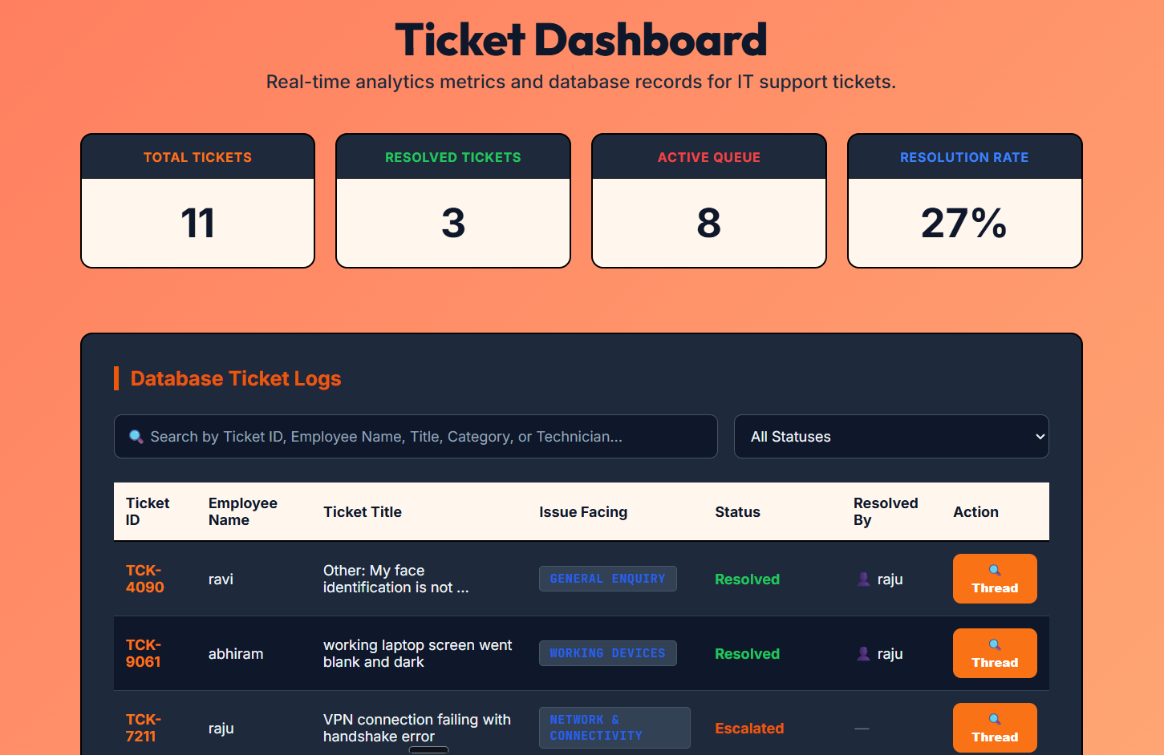
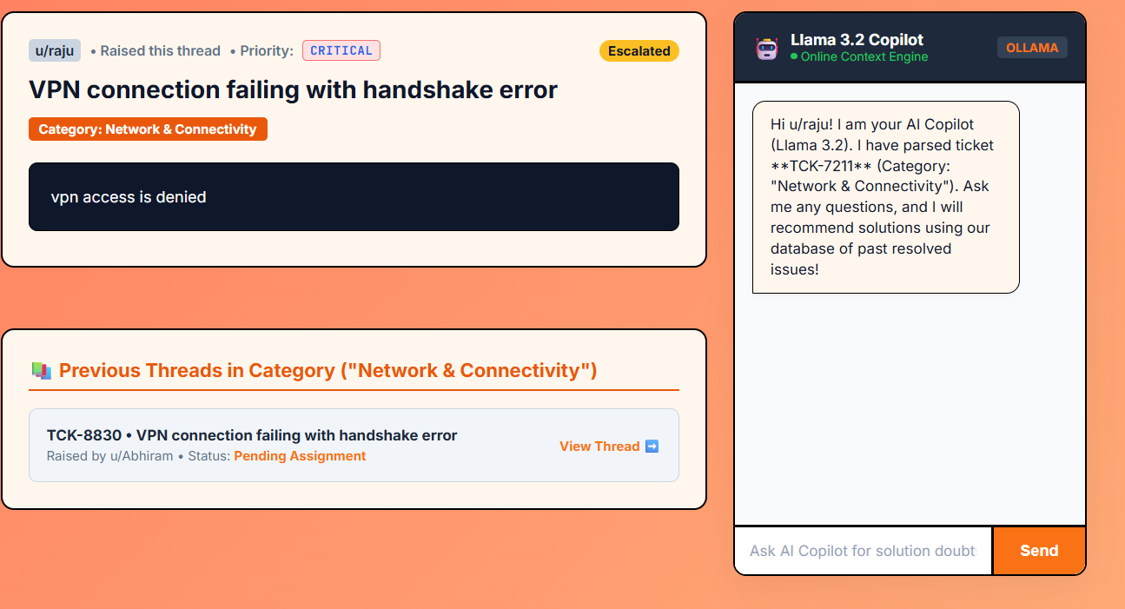
Ticket Logs and Llama3.2-Powered Chatbot

Slide 7
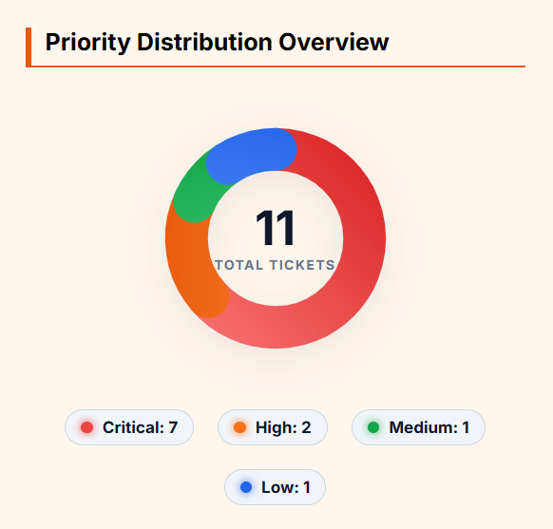
AI Analysis & Executive Dashboard
Priority Distribution
Premium Donut Visualization:
• Thick segment rings: 36px stroke width layout instead of thin lines.
• Curated visual elements: Uses premium linear gradients to match our slate-orange color system.
• Responsive SVG arcs: Built with custom SVG stroke dasharrays and smooth rounded caps.
• Interactive Legend: Pill-shaped indicators displaying real-time percentages of Critical/High/Medium/Low priority runs.

Slide 8
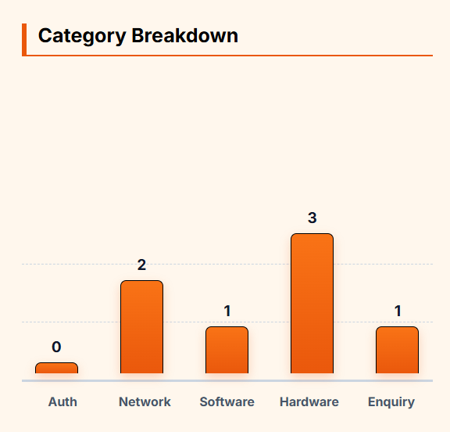
AI Analysis & Executive Dashboard
Category Breakdown
Vertical Bar Chart Visualisation:
• Clean structure: Removed messy line charts and replaced with premium vertical bar grids.
• Rounded top corners: Soft borders blending cleanly with the UI.
• Gradient bars: Smooth colour fades from orange to dark orange representing ticket volumes.
• Grid guidance: Subtle dashed background guide rules to track relative scale of Network, Hardware, and Software tickets.

Slide 9
Robust Offline Resilience
Multi-Tier Offline Protection Heuristics
- Diagnostic Indicators: Real-time UI alerts checking database and Ollama VM statuses, warning users if a server goes offline.
- Prediction of the ticket and integrating multi-AI agents to solve the issue without any human intervention.
- Fallback Database Chat Queries: Chatbot runs keyword matching against SQLite resolved tickets when local Ollama VM is unreachable.
- Zero Crashing Guarantee: Gracefully notifies user of status instead of stalling UI elements or crashing API calls.

Slide 10
Project Summary
Successfully delivered a modern, AI-integrated ticketing platform featuring a premium Peach Matte design, secure Admin panels, local Llama 3.2 chatbot assistance, and database fallback search tools.
Thank You!

